Slide 1
Sup # 2.0
Sup # 2.0

Slide 2
Attribute
description

Slide 3

Antarctica
we’re a cool place.

Slide 4

Aventurina
visionyze the future

Slide 5
NioTech
National Institute of Technologics

Slide 6
Synactris
description

Slide 7

Light Mode Lover
except for coding and graphic design ;)

Slide 8
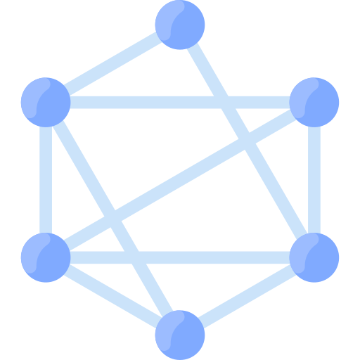
Introvert
silent, reserved, observant, lone

Slide 9

Curious
interested by literally anything

Slide 10

Independent
self-learning & self-discipline

Slide 11

Driven
sometimes I wonder if it’s too much of an undertaking

Slide 12

Creative
just look at Assort

Slide 13

Focused
wait, how’d the time fly?

Slide 14

Serene
speak only when strictly necessary

Slide 15

Overthinking
analyze everything

Slide 16

Turbulent
if only my mind could stop...
just for a bit.

Slide 17

Nihilist
there is no glass, life is a lie

Slide 18

Game Development
first and foremost, forever

Slide 19

Programming
made for this

Slide 20

Graphic Design
typography, colours, aesthetics

Slide 21

Music Creation
on-off for so many years

Slide 22

Piano
entire life

Slide 23

Drums
pure utter fun

Slide 24
Skyscrapers
unknowingly enrapturing

Slide 25
Card Games
Yu-Gi-Oh!, Pokémon, self-created

Slide 26

Reading
dystopian fantasy future fiction

Slide 27

Tennis
just for fun

Slide 28

Organic Chemistry
nomenclature & synthesis

Slide 29
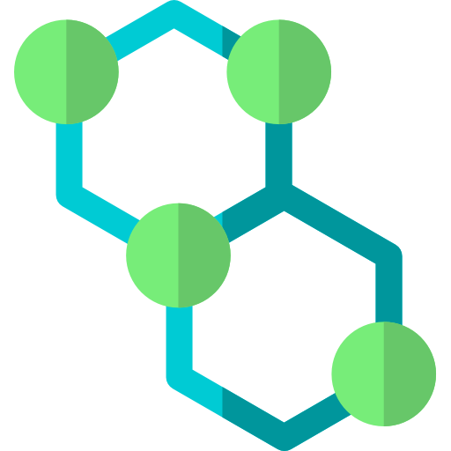
Biochemistry
at least I like to think. Amino acids & saccharides are utterly fascinating.

Slide 30

Geometrics
hexagons are the bestagons

Slide 31

Complex Numbers
i is just such a cool unit.

Slide 32
Electronic Music
NCS and the like

Slide 33

Epic Music
film themes and all that

Slide 34
Artcore
I don’t even know anymore at this point.

Slide 35

Language
etymology, nomenclature, orthography fanatic

Slide 36

Professional Procrastinator

Slide 37

Burst
high speed, low stamina

Slide 38

Speedcuber
18.34 seconds

Slide 39
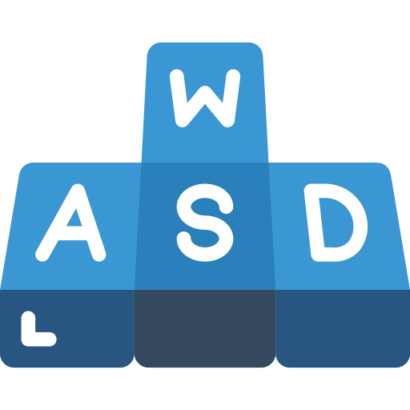
Speedtyper
130+ WPM

Slide 40

Sino-Antarctican Neo-English
the official linque of Antarctica

Slide 41
English
British

Slide 42
Chinese
Mandarin

Slide 43
French
not fluent by any means, but yeah

Slide 44
German
dropped, familiar enough

Slide 45

Scratch
forever loved

Slide 46

Python
practically fluent

Slide 47

HTML
enough to get by

Slide 48
CSS
the coolest cascading name

Slide 49

Swift
cool language

Slide 50
C#
I’m coming round to love it icl

Slide 51

Markdown
technically markup but whatever

Slide 52

LATEX
just the basics

Slide 53
supcode
a conceptual programming language created by yours truly

Slide 54
Carbon
eh looks alright, give it a shot

Slide 55

MySQL
delved into slightly

Slide 56
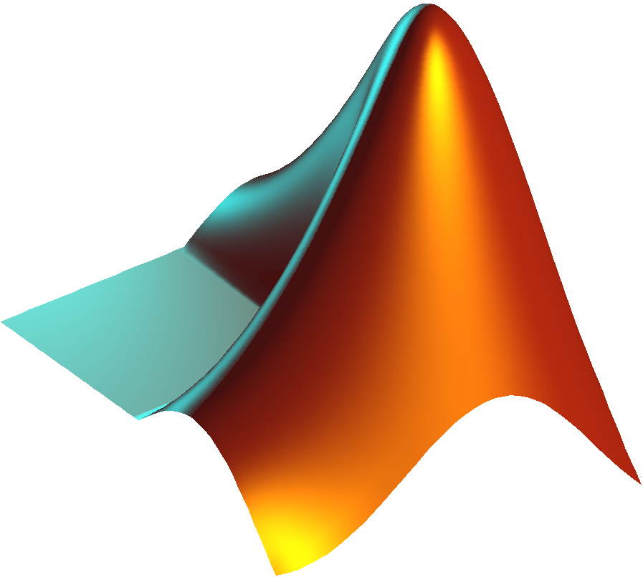
MATLAB
will learn eventually

Slide 57

JSON
does this even count?

Slide 58

PowerPoint
2016 Offline

Slide 59

Visual Studio Code
quick, tactile, versatile, extensive

Slide 60
Unity
laggy af on my poor laptop but eh

Slide 61
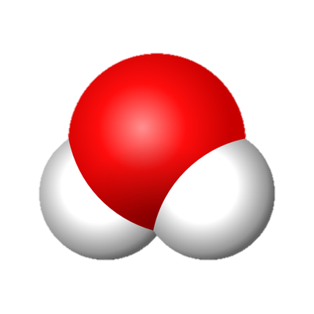
MolView
why can’t any other chemical editor be this smooth and simple?

Slide 62

IDLE
the only quick and convenient interactive Python shell

Slide 63

replit
lacklustre IDE but keeps bots alive

Slide 64

iMovie
free, simple, integrated

Slide 65

MuseScore
unrivalled clean and customisable UI

Slide 66

iOS
always.

Slide 67
iPadOS
not even close.

Slide 68

Windows 10
Apple for mobile, Windows for desktop

Slide 69

XPS
sleek and flexible

Slide 70

Phigros
the ultimate rhythm game

Slide 71

Master Duel
Dogmatik Drytron, Mathmech, Raidraptor, Cyber Dragon

Slide 72

Bloons TD 6
the only game in the world that even comes close to perfect for me

Slide 73

Bloons Pop!
casually playing

Slide 74
Minecraft
everlasting

Slide 75

Asphalt 8: Airborne
until the Fast Lane Update

Slide 76

ASPHALT 9: LEGENDS
until the Fire & Lightning update

Slide 77

Soul Knight
pure destructive fun

Slide 78

Bomb Party
literally the perfect game for me

Slide 79
littlebigsnake.io
description

Slide 80
diep.io
description

Slide 81
arras.io
description

Slide 82
Slytherin
cunning, reserved, secretly observant

Slide 83
Ravenclaw
intelligent, creative, learning

Slide 84

Wand
12.25", sycamore & phoenix feather, surprisingly swishy flexibility

Slide 85
Patronus
grizzly bear

Slide 86

Holyhead Harpies
no it’s not cuz they’re all women, just they have the absolute coolest name

Slide 87
Koniokinetis
dust manipulyzation

Slide 88
Invis
invisibility

Slide 89
Incorporealis
incorporeality

Slide 90
Teleportalis
rapid instant teleportacion

Slide 91
Portagenetis
portal generacion

Slide 92

Scratch
@Sup2point0

Slide 93

FANDOM
Sup2point0

Slide 94

Sup#2.0
u/Sup2pointO

Slide 95
BLOONS WIKI
a really, really developed profile

Slide 96
PVZ WIKI
description

Slide 97
ASPHALT WIKI
description

Slide 98
SOUL KNIGHT WIKI
f

Slide 99

Hermitcraft
devoted viewer since Season VI

Slide 100

The Life Series
3rd Life, Last Life, Double Life, Limited Life

Slide 101

Ultraman
Tiga, Dyna, Mebius, Saga, Ginga, X, R/B, Z, Trigger, Decker

Slide 102
Yu-Gi-Oh!
Battle City, Arc-V, VRAINS, ZEXAL

Slide 103

Pokémon
XY, XYZ, Sun & Moon

Slide 104

Wikipedia
I read Wikipedia in my spare time.

Slide 105

Fanfiction
I swear to xenique I’m on life support

Slide 106
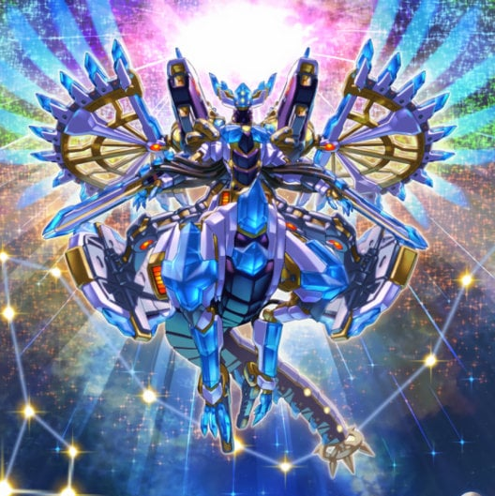
Yu-Gi-Oh Duelist
Dogmatik Drytron, Raidraptor

Slide 107
Fandom
once avid editor

Slide 108

Monkeyopolis Times
retired editor

